Slide 1
AUTOMATIC DRAIN CLEANER
R.SATHANA

Slide 2
ABSTRACT:
The project aims at replacing the manual work in “Drainage Cleaning” by a automatic machine handled by a human. In this modern lifestyle everything is mechanized yet here we are indulging humans in drain cleaning.
Drainage pipes are used in disposal of wastes yet, becomes lethal when blockage is cleaned manually. Let it be the harmful bacteria or deadly virus or even hazardous gases they are the sole reason in taking lives away , when humans are openly exposed to sewage pipes or tanks without a proper safety gear.

Slide 3
INTRODUCTION:
Automatic drainage water cleaning and control system using auto mechanism is proposed to overcome real time problem. Our proposed system is to clean the drainage and to monitor the drain level by auto mechanism.
This is a low budget , simple and basic project involving assured output.

Slide 4
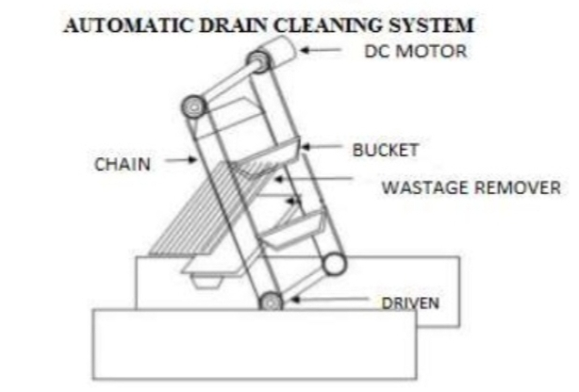
MODEL:

